Slide 1
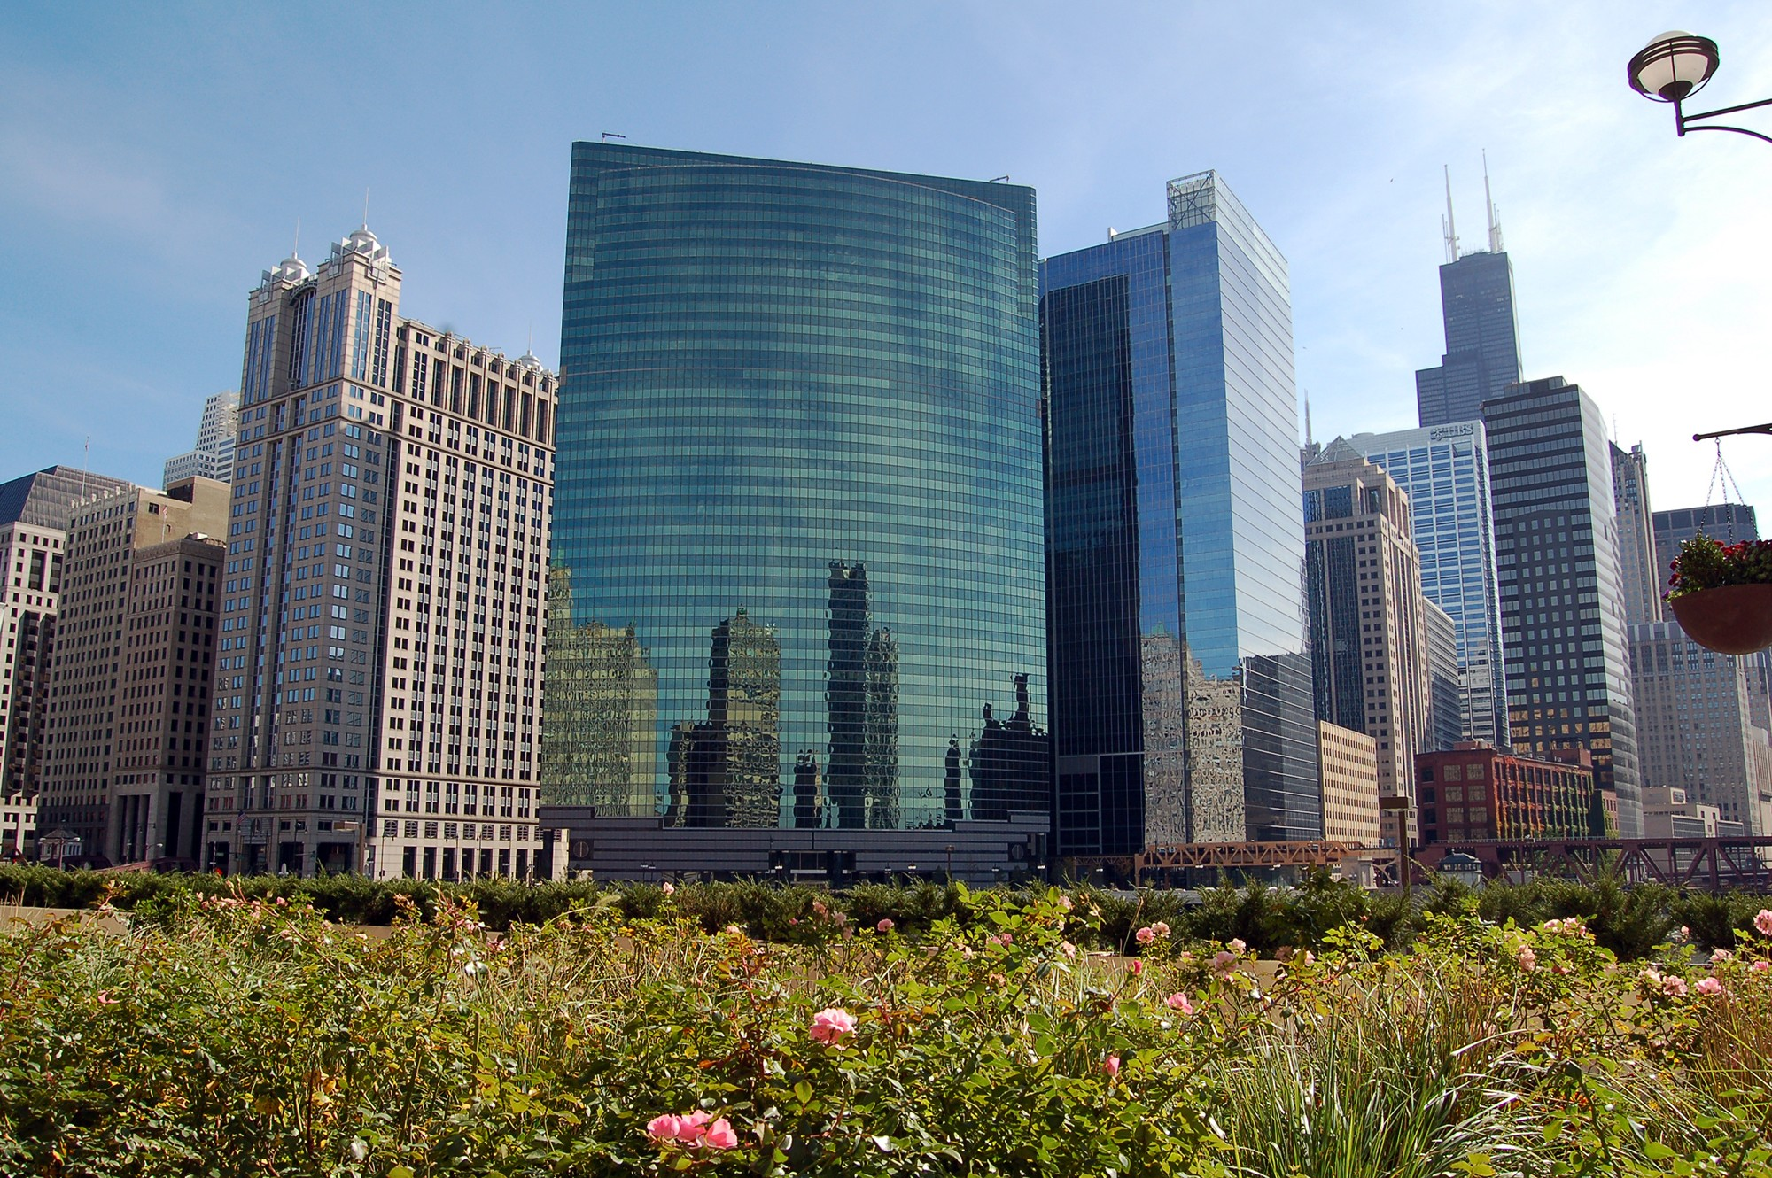
Nuveen ADR Statistical
Models
NAME OR LOGO

Slide 2

Agenda
Background
Project Approach Analysis Results
Recommendations

Slide 3
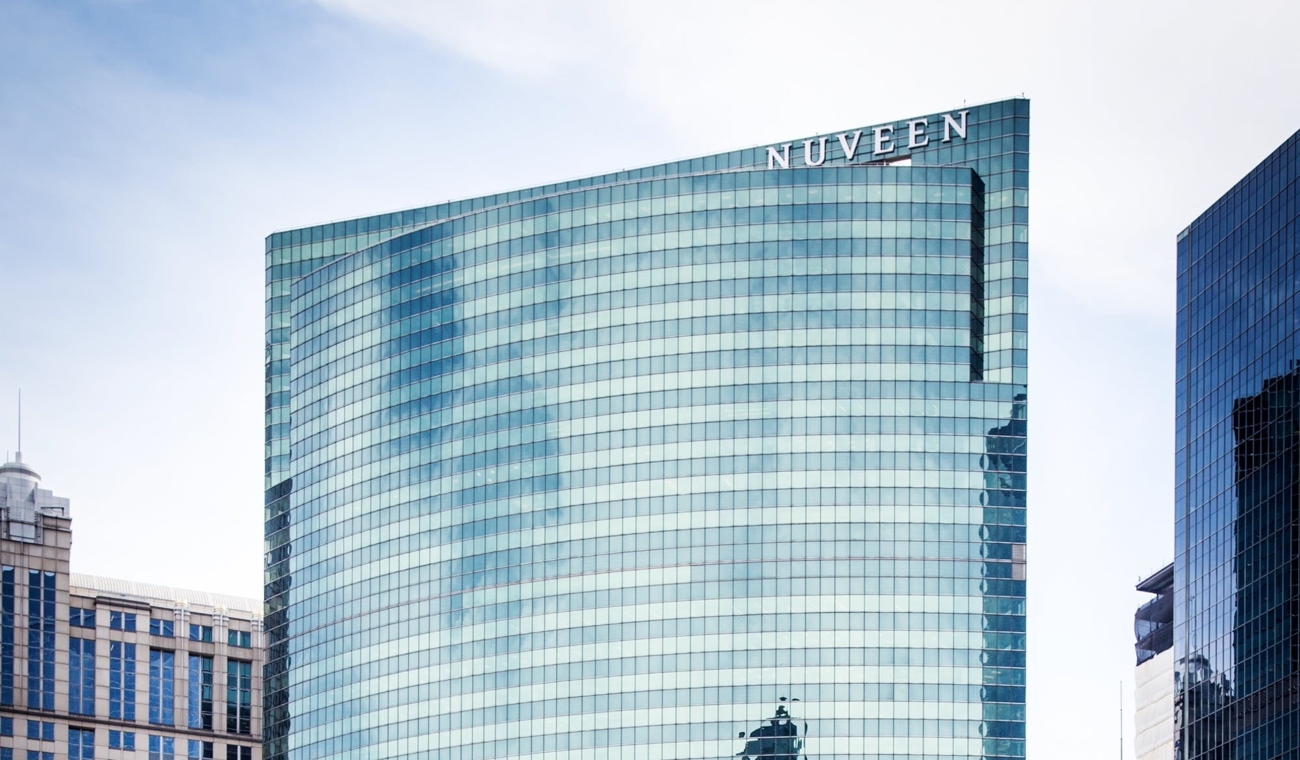
Background
Nuveen maintains its international headquarters in Chicago, with major offices in New York City, Charlotte, San Francisco, London and secondary offices in Frankfurt, Los Angeles, Shanghai, Singapore, Rio de Janeiro, Vienna, Stockholm, Minneapolis, Montreal, Washington DC, Tokyo, Luxembourg, Madrid, Milan, Paris and Miami.
Nuveen was acquired by TIAA for $6.3B from its private equity owners in April of 2014.
Nuveen is tasked with marketing and selling mutual funds through investment professionals (brokers, financial planners, financial advisors).

Slide 4
Background
Nuveen, formerly Nuveen Investments, a subsidiary of TIAA, is an American global investment manager
Nuveen is one of the largest investment managers in the world with $1.2 trillion in assets under management
Nuveen is strongest in bond funds, ranking first specifically in tax-free municipal bonds.

Slide 5
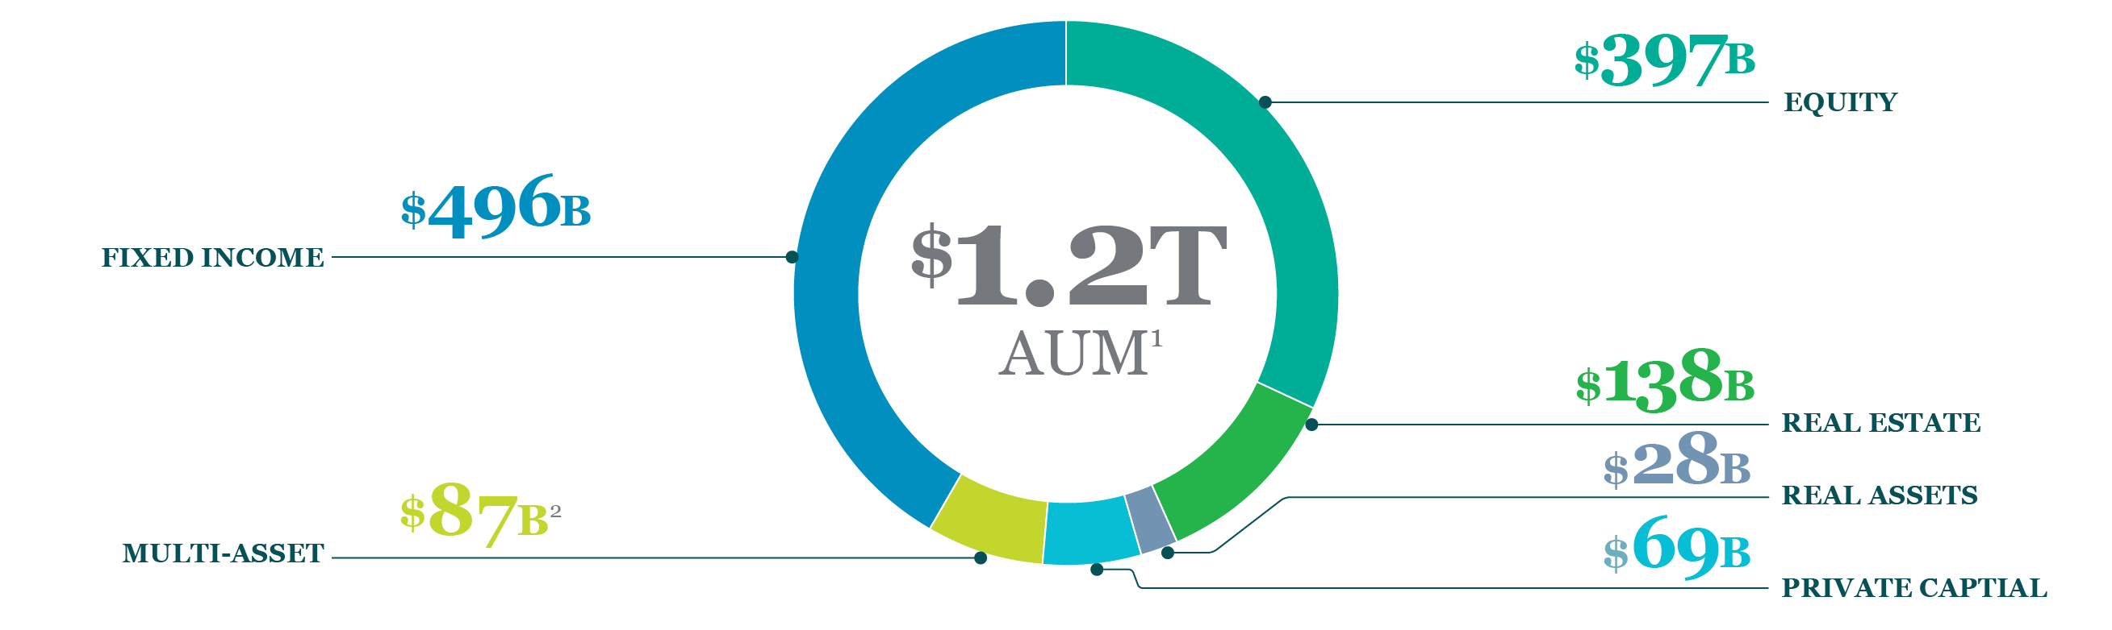
Background
NAME OR LOGO

Slide 6
Project
GOALS
+
OBJECTIVES
Acquire new clients cost-effectively, sell more to existing clients, reduce redemptions (ADR –acquire, develop, retain)
It is likely that Nuveen has a relatively small percent of clients that account for a high percentage of their profit
Assist sales and marketing by improving their targeting, and allowing them to correctly assign coverage channels
Predict sales for 2020 using the data for 2018 and 2019
Determine the optimal number of models that need to be built
Develop several regression analyses and show the lift that will be achieved through your models

Slide 7
Approach
Read
Data
Exploratory
Data
Analysis
Data Cleaning
and
Prep
Train
Test
Split
Build
Pipeline
Build
Regression Model
Model Evaluation
and
Lift
Final
Recommend-ations

Slide 8
Approach
Data Cleaning Pipeline
Advisers(Months)
=
360,000 records
Train
240,000 records
Test
120,000 records
Split
Sales
175,175 records
Redemptions
64825 records
Fit
Drop

Slide 9
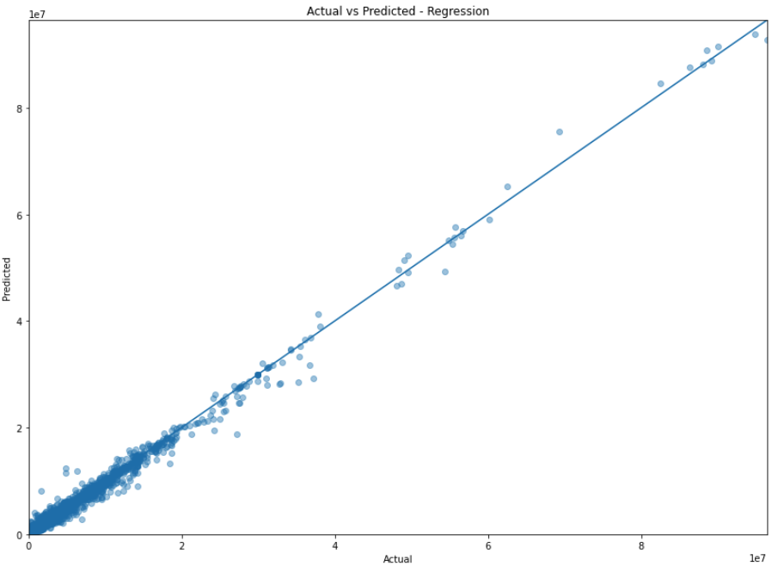
Model
Random Forest Regressor
99.3% Accurate

Slide 10
Lift

Slide 11
Recall
TOTAL AUM
NAME OR LOGO

Slide 12
Grades

Slide 13
AAA
2020 Appreciation
$2.2B
$31.5B
$38B
$79M
$4.4B
$32M
$141M
NAME OR LOGO

Slide 14
AA+
2020 Appreciation
$495M
$4.76B
$5.9B
$49M
$660M
$10M
$4M
NAME OR LOGO

Slide 15
AA
2020 Appreciation
$(261)M
$712M
$699M
$2M
$237M
$7M
$1.9M
NAME OR LOGO

Slide 16
Recommendations
Further study should include investigating the deciles of the respective deciles
In-person Visit
Grades AAA and AA+
Adviser account development and retention are relatively homogenous compared to other tiers
Grades AA to A+
Phone Call
A/B Testing and Further Study needed to determine which resources are (in)effective
Grades A and below
Email

Slide 17
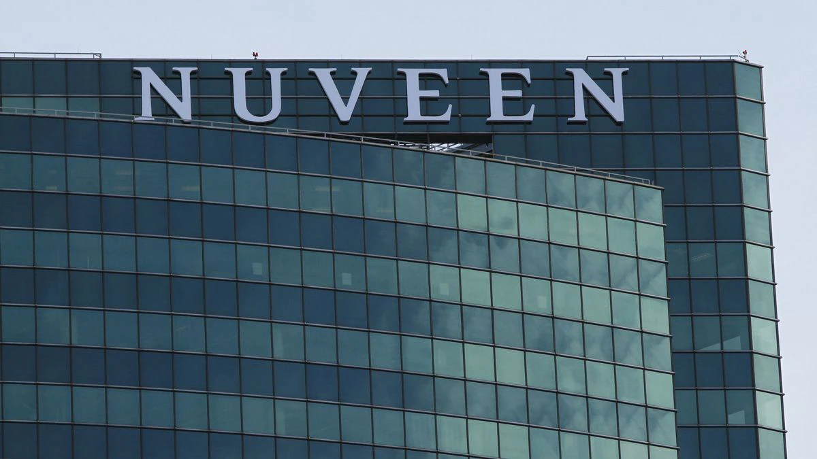
Thank You

Slide 18
Appendix

Slide 19
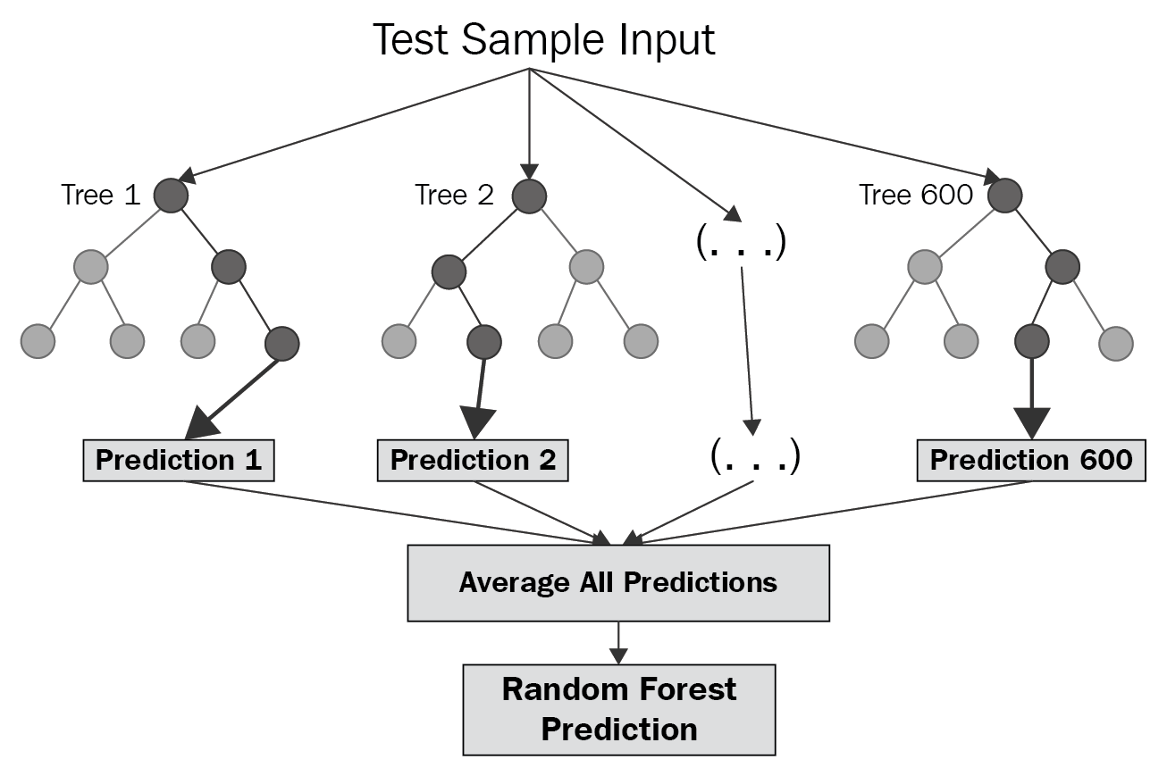
Random Forest

Slide 20
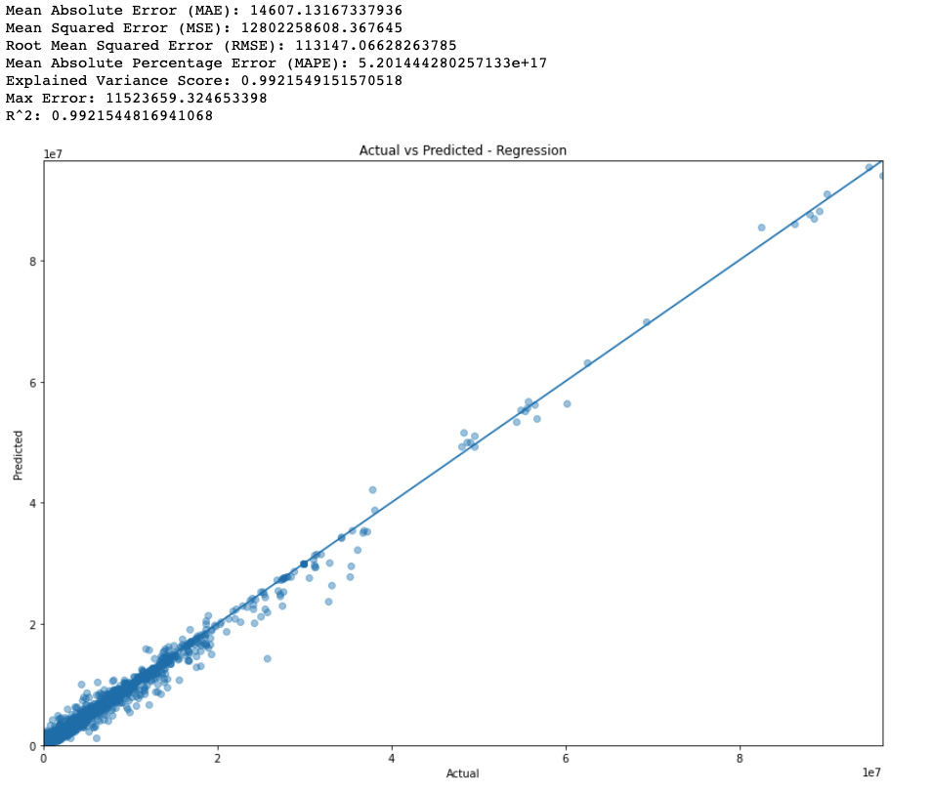
Model Metrics

